Slide 2
Axion360°
A Modern Digital Banking Solution

Slide 3
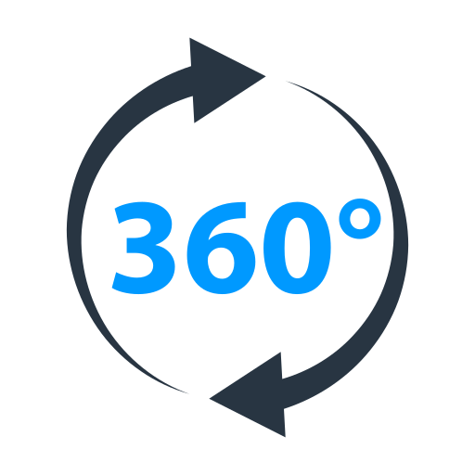
Application Name and Logo:
Axion

Slide 4





Team Member:
Avisheikh Kundu
221-15-5009
Ovi Sarker
221-15-4736
Robiul Hassan Nafis
221-15-5099
B.M. Sabbir Hossen Riad
221-15-5267
Jannatul Firdaus Mariam
221-15-5644

Slide 5
Introduction
Vision:
Provides secure, convenient, and innovative digital banking solutions, empowering customers to manage their finances seamlessly and efficiently.
Mission:
Revolutionize traditional banking through a fully digital experience.
Key Benefits:
Streamlined operations
Enhanced user convenience
High-level security
Real-time transaction handling

Slide 6
Objectives
Accessibility: 24/7 account access across devices.
User Interface:
Simple and user friendly
Consistent
Responsive across devices.
Transaction Processing:
Reliable
Quick processing with real-time updates
Security:
Encryption
Secure password storage
Access controls

Slide 7
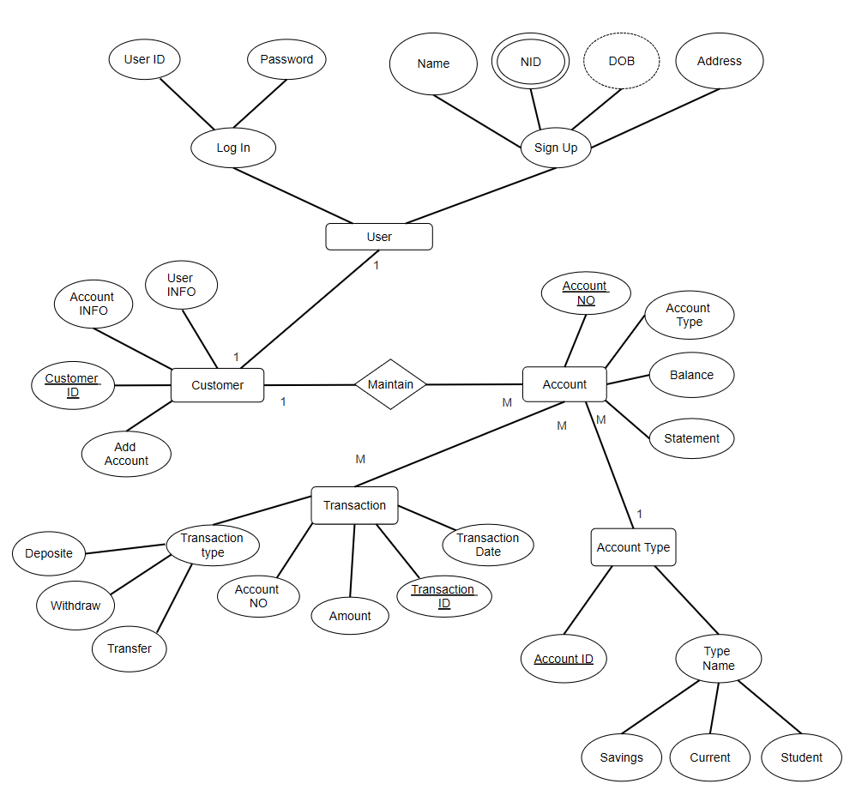
ER Diagram

Slide 8
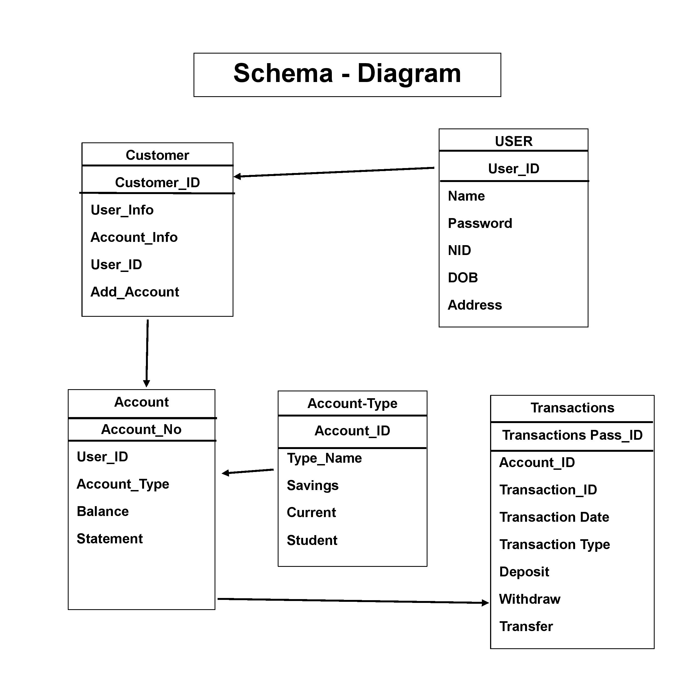
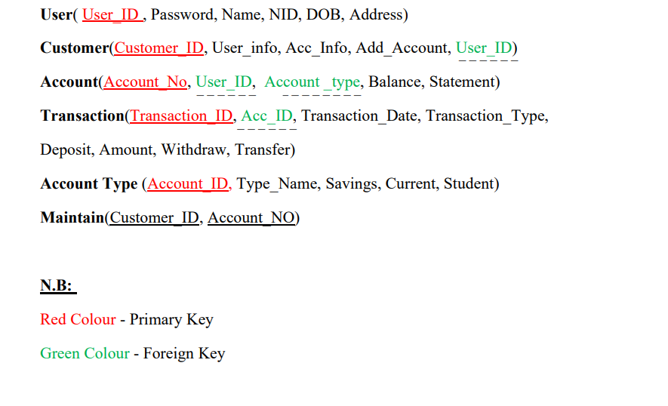
Schema

Slide 9
Feasibility Analysis
Technical Feasibility:
Assess tech requirements, compatibility, and skill needs.
Economic Feasibility:
Cost analysis, potential ROI, funding sources.
Operational Feasibility:
Resource and stakeholder readiness, process adaptation.
Legal Feasibility:
Compliance with regulations

Slide 10
Technical Overview
Technology Stack:
Frontend: JAVA Swing,HTML, CSS, JavaScript
Backend: PHP or Node.js
Database: MySQL/PostgreSQL
Web Server: Apache ,MYSQL or NGINX

Slide 11
System Requirements
Hardware: High-performance servers, scalable storage
User Interface: Accessible, responsive design.
Software: Compatible OS, relational DBMS, web server.
Security: Multi-factor authentication, data encryption, firewalls.
Performance: Load handling, optimized response times.

Slide 12
System Design
UI Design: Wireframes, user feedback loops for refinement.
Database Design: Schema, normalization, indexing.
Application Architecture: Three-tier model for scalability.
Security: Role-based access control, encryption protocols.
Integration: Standard protocols for interoperability.

Slide 13
Features and Functionalities
User Management: Registration, login, profile management.
Account Management: View balances, manage multiple accounts.
Transaction Management: Fund transfers, transaction tracking.
Search Facility: Advanced filters for specific transaction records.
Security Features: End-to-end encryption, fraud detection.
Customer Support: FAQ, live support, and ticketing system.

Slide 14
Advantages of the System
Enhanced Security: Multi-factor authentication and regular updates.
Efficiency: Automated processes, quick transactions.
User-Friendly Interface: Easy navigation, mobile-friendly.
Scalability: System designed to handle future growth.

Slide 15
Conclusion

Slide 16

Q&A

Slide 17
Thank You

